Slide 1

Final Project: Why go Solar
Team Sunny Day:
Jacob Zebker, Kellen Schmitz, Chung In “Angel” Ngan, Angela Kumar
Instructor: Andrew Hoang
Bootcamp: UCB-VIRT-DATA-PT-06-2021-U-B-TTH

Slide 2
Selected Topic
Analysis of solar energy potential for a given location (in US) to save on electricity and does one qualify based on the number of sunny days or global horizontal irradiance(GHI) that your location and state incurs.
Global Horizontal Irradiance measures the brightness of the sun in a given location around the globe. However for the purpose of this project, we have focused only on the Contingous United States.

Slide 3

Purpose and Overview
The topic was selected due many factors:
Climate change and global warming
Power outages, wildfires, and other natural disasters
Increased greenhouse gas emissions
Increased interest in renewable energy specifically rooftop solar and energy storage.
Cost savings on electric

Slide 4
Description of the Source of Data
The source data was primarily from Governmental Sources.
Resources include:
https://www.eia.gov/electricity/state/
https://www.nrel.gov/gis/solar-supply-curves.html
https://developer.nrel.gov/docs/solar/nsrdb/ = There is an API for some weather data, based on longitude and latitude
Additional likely sources include: WeatherData, Department of Energy, NOAA.gov, NASA, trade groups

Slide 5

Questions We Hope to Answer with the Data
When including a variable such as zip code does the global horizontal irradiance predict accurately for the zip code entered?
Does the zip code entry fall into a bright zone or dark zone? Meaning farther from the sun, or in a location that has extreme weather? (i.e., rain, snow, fog, or other vulnerabilities)
How many years will it take to breakeven with the cost of installing rooftop solar

Slide 6
Description of the Data Exploration Phase
Difficult to find current data
Lots of locations for historical data
Data can be clean or messy depending on source

Slide 7
Machine Learning Prediction
Explanation
By Jacob Zebker

Slide 8
Machine Learning Demo

Slide 9
Data Visualization with Tableau
Insert Explanation
By Chung In “Angel” Ngan

Slide 10
Tableau Visualization

Slide 11
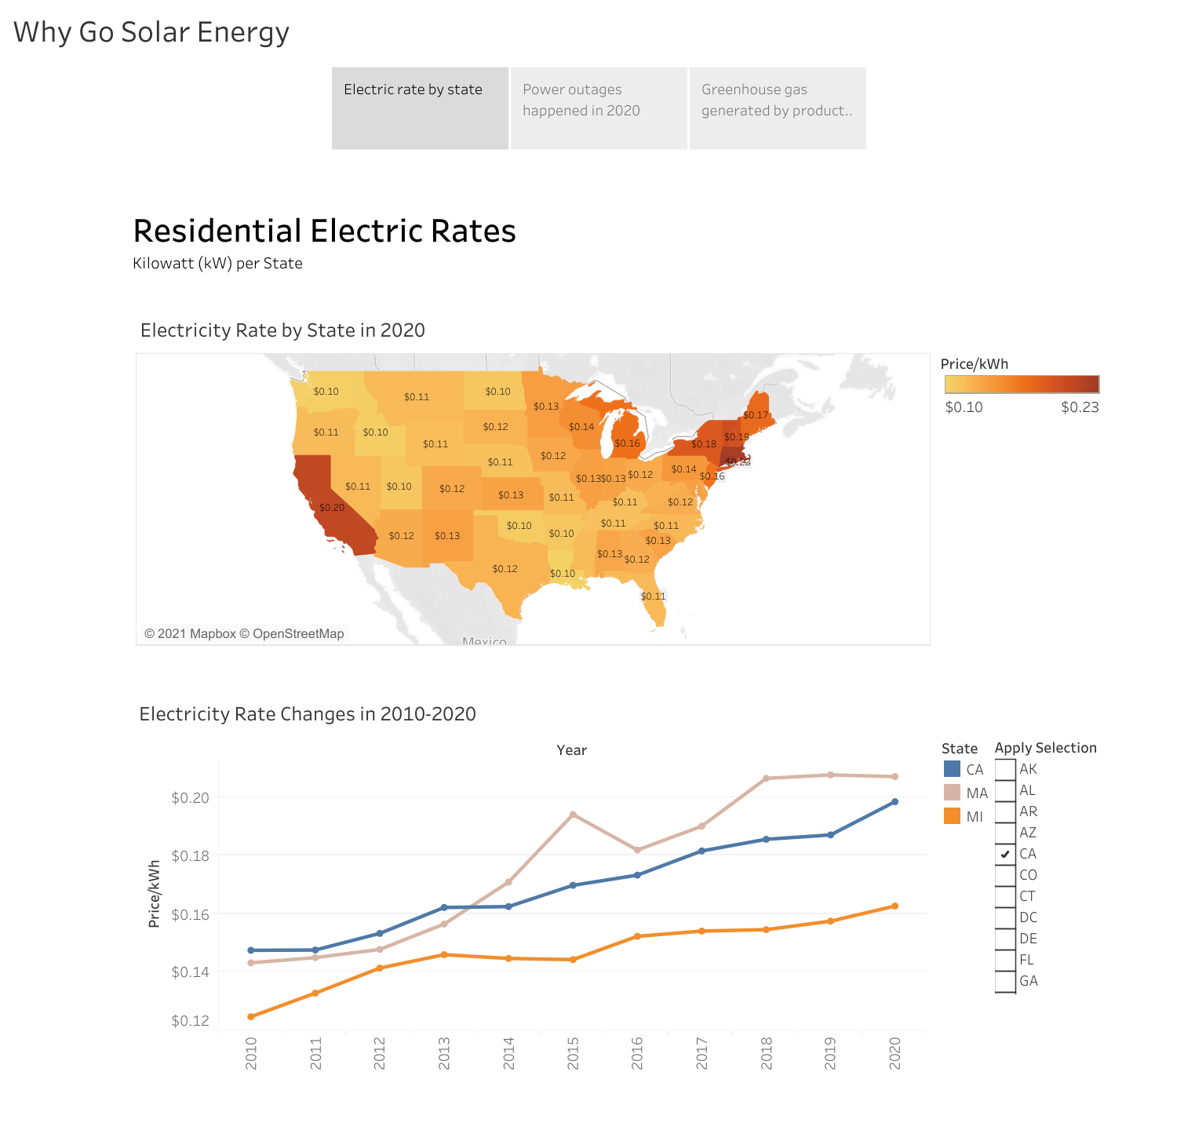
Tableau Visualization: Electric Rates

Slide 12
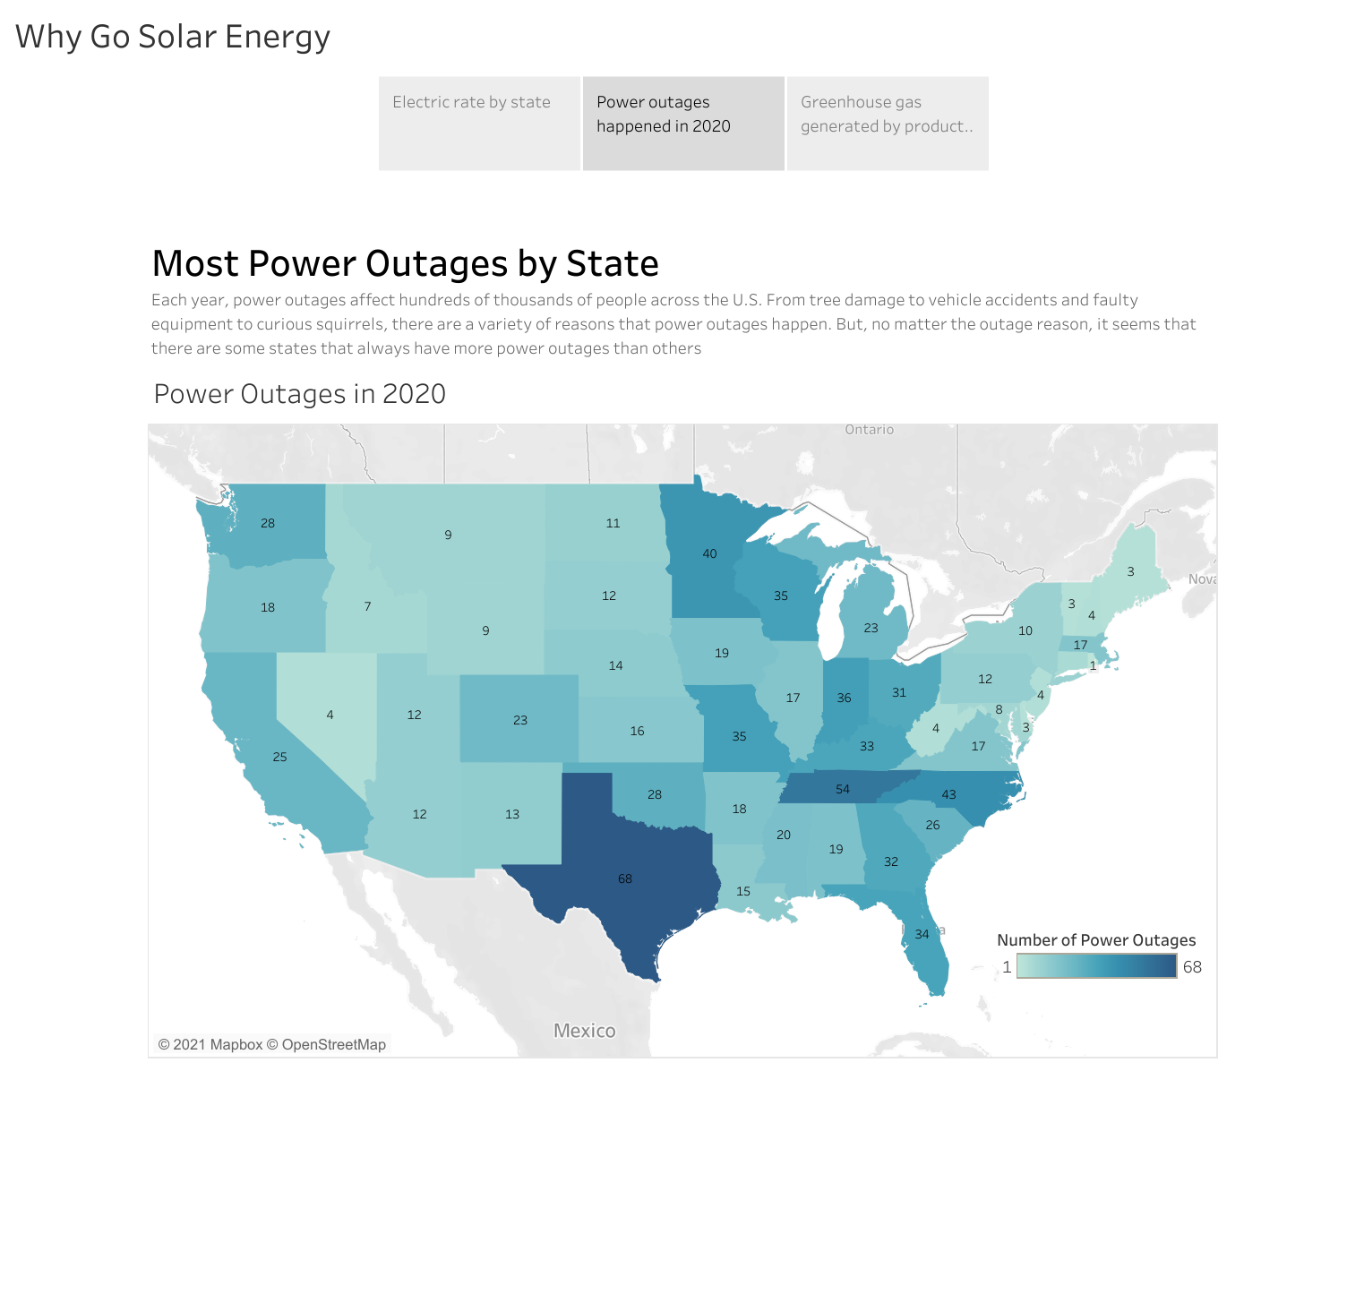
Tableau Visualization: Power Outages

Slide 13
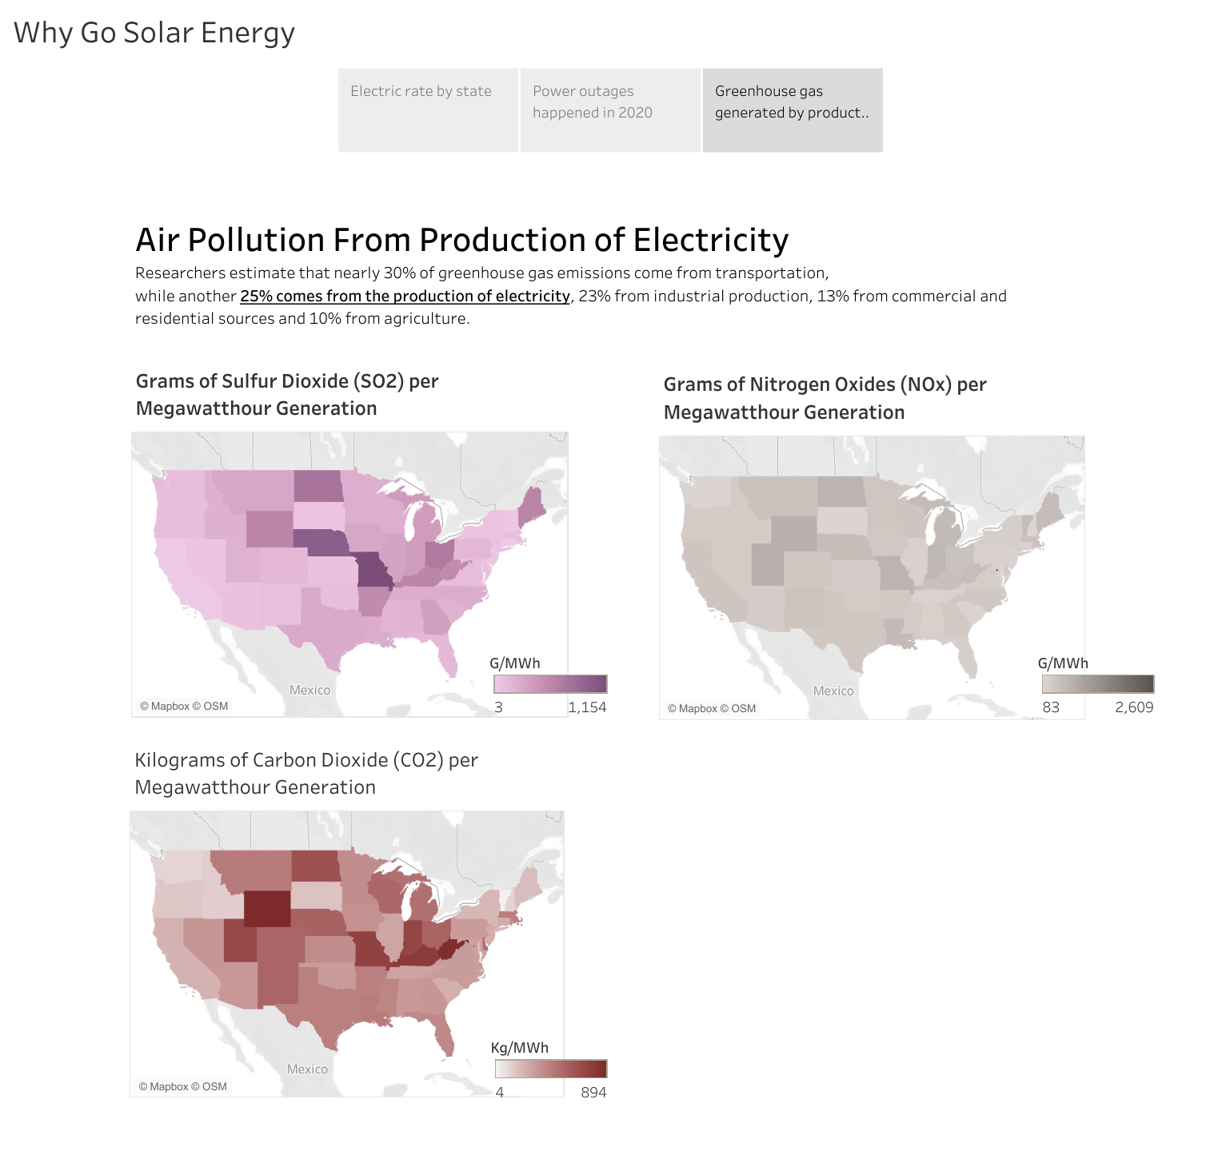
Tableau Visualization: Greenhouse Gases

Slide 14
Description of the Analysis Phase
Solar Calculator Analysis
By Kellen Schmitz

Slide 15
Solar Calculator

Slide 16
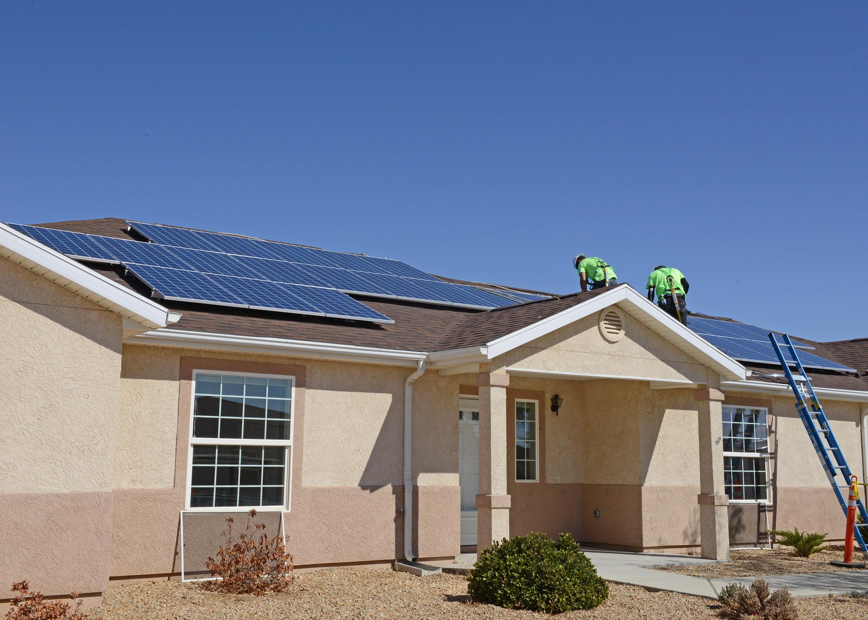
Summary of Our Finding as Team Sunny Day
Climate change is real and we need to do something about the planet.
Renewable energy such as solar, specifically photovoltaic panel installation can be used on the rooftop saves on electric savings.

Slide 17
Conclusion on what we learned in class
Data can be made to forge a relationship with unrelated data to gain more insight, perspectives, or have better outcomes with Pandas, PostgreSQL.
We learned new technologies to present our findings with Tableau, Plotly, and Javascript
It is how we are able to use data to communicate our ideas, persuade another to make key decisions.
Data is used to review trends and patterns and can train the computer to make predictions or test assumptions using supervised and unsupervised machine learning.

